Slide 1

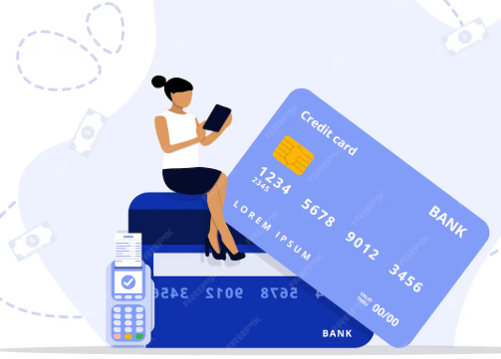
Strategic Insights For MITRON Bank’s New Credit Line
Presented by Parth Patoliya

Slide 2
Agenda
Provide Insights to the Product Strategy Team in the Banking Domain
Problem Statement
Project Objective
Dataset View
Key Insights
Strategic Suggestions

Slide 3

Problem Statement
Mitron Bank is a legacy financial institution based in Hyderabad planning to launch a new credit card product to expand its market reach and product portfolio.
Due to risk concerns and lack of data-driven clarity, the strategy director requested a pilot analytics project using a sample dataset of 4,000 customers across five major Indian cities before approving a full-scale rollout.

Slide 4




Project Objective
Income Utilization By Different Segments
Customer Demographics
Income Analysis
Spending Pattern

Slide 5
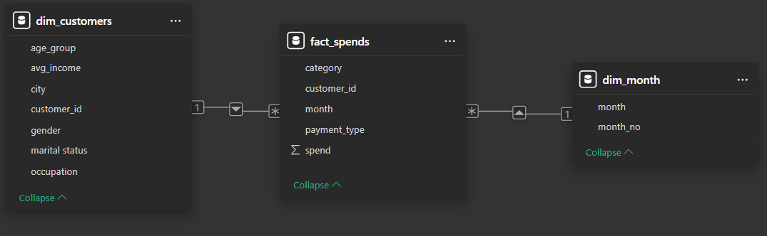
Dataset View

Slide 6

Key Insights

Slide 7
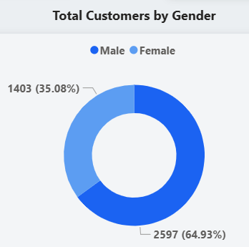
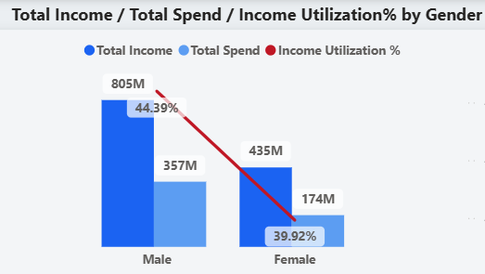
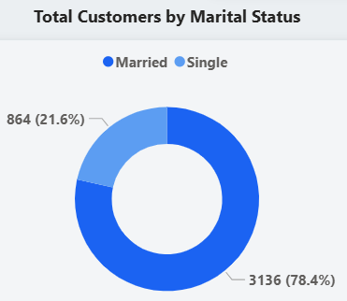
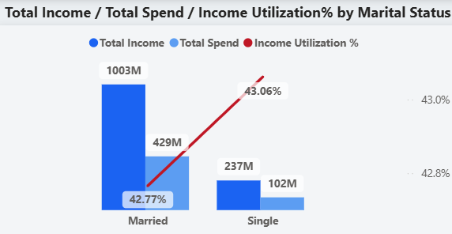
Total Customers: 4000
Gender Distribution:
Male : 2597 (65%) | Female : 1403 (35%)
Married : 3136(79%) | Single : 864(21%)
Total Income:
Male : 805M | Female : 435M
Married : 1003M(81%) | Single : 237M(19%)
Total Spend:
Male : 357M | Female :174M
Married : 429M(81%) | Single : 102M(19%)
Income Utilization%:
Male : 44.39% | Female : 39.92%
Married : 42.77% | Single : 43.06%

Slide 8
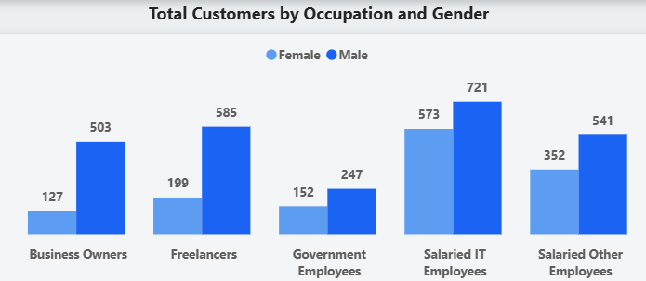
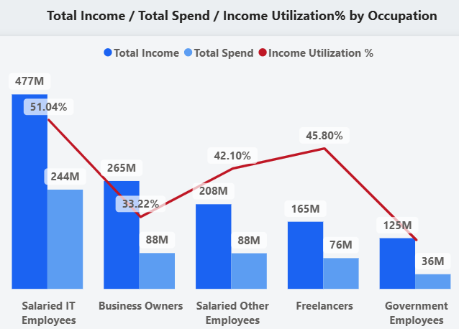
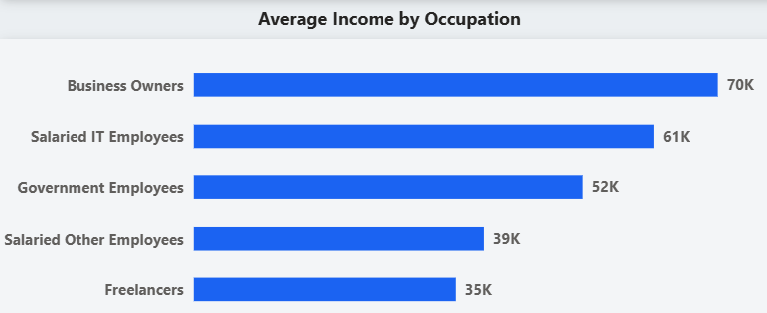
Salaried IT Employees dominates with
Total Customers : 1294
Total Income : 477M
Total Spend : 244M
Income Utilization% : 51.04%
Freelancers – 2nd highest Utilization(45.80%)
Business Owners have higher average Income(70k) but utilization is very low(33.22%)
Government Employees shows lower Spend & Utilization

Slide 9
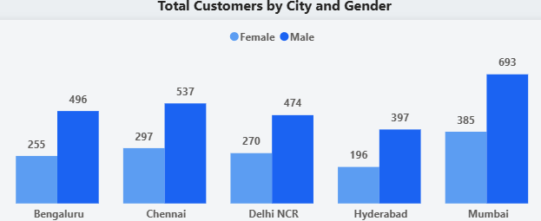
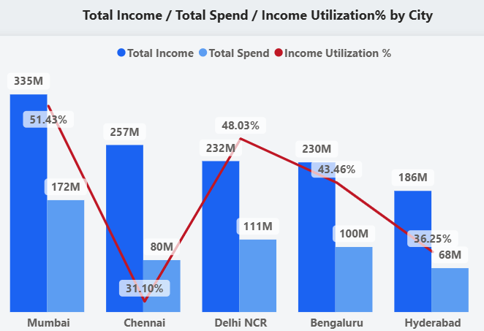
Mumbai has highest :
Total Customers : 1078
Total Income : 335M
Total Spend : 172M
Income Utilization% : 51.43%
Delhi : 2nd highest Utilization(48.03%)
Chennai : lowest Utilization(31.10%)
Hyderabad : lowest Spend(68M)

Slide 10
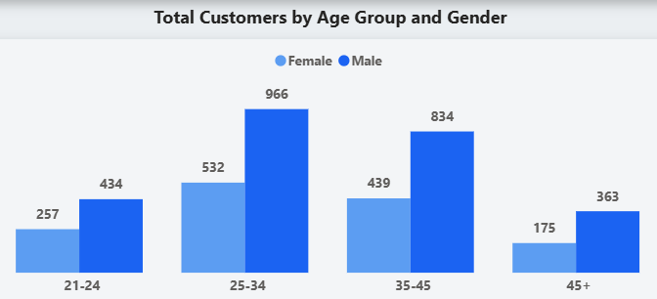
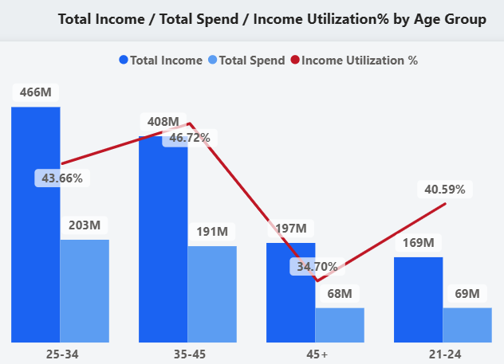
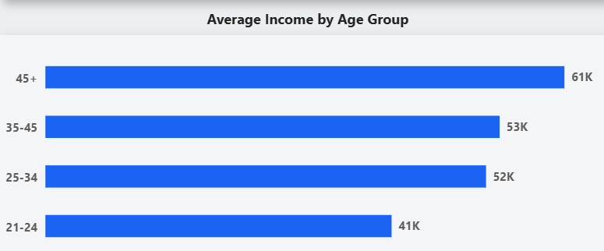
25-45 covers total 2771(70%) customers
45+ has highest average income (61k)
35-45 : high utilization 46.72%
25-24 : 2nd highest utilization 43.66%

Slide 11
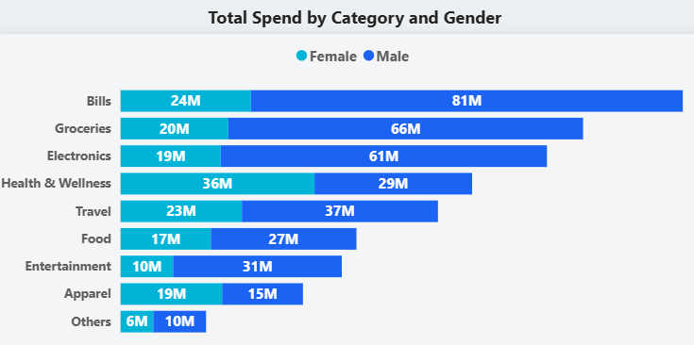
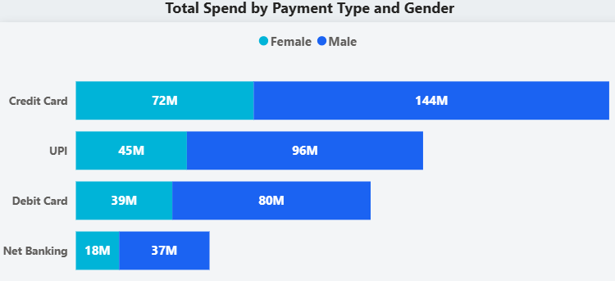
Bills : 105M
Groceries : 86M
Electronics : 80M
Health & Wellness : 65M
Travel : 60M
Food : 54M
21-24 spends more on Entertainment, Apparel, Food
Credit Card : 216M(41%)
UPI : 141M(27%)
Debit Card : 119M(22%)
Net Banking : 55M(10%)

Slide 12
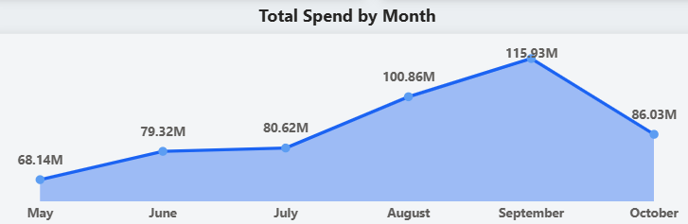
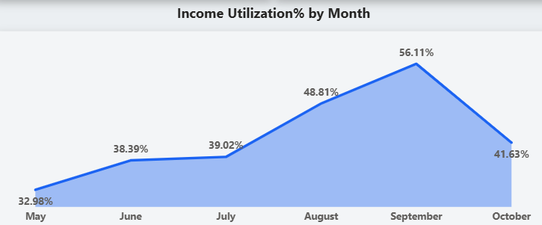
September has highest :
Total Spend : 115.93M
Income Utilization : 56.11%
May shows lowest :
Total Spend : 68.14M
Income Utilization : 32.98%
Aug-Sept spending spikes (Festive Periods)
Sep-Oct sharp decline (off-season, price sensitivity)

Slide 13
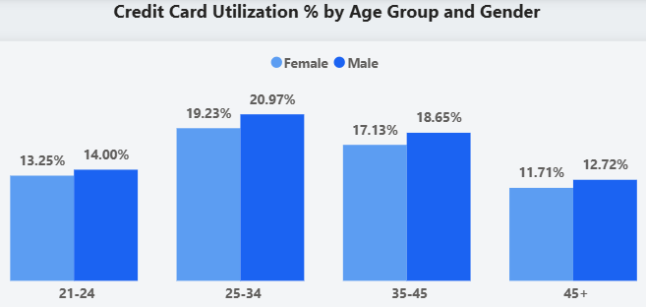
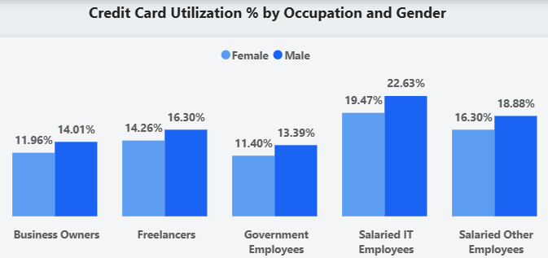
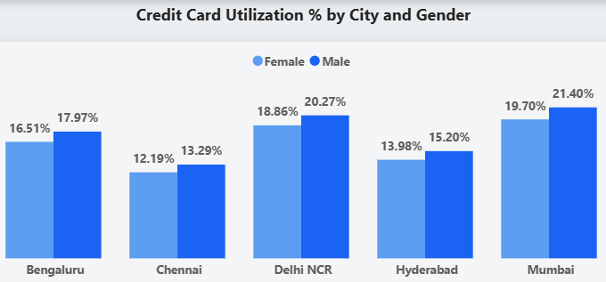
Top Segment
Salaried IT Employees : 22%
25-34 : 20%
Mumbai : 21%
Bottom Segment
Government Employees : 12%
45+ : 12%
Chennai : 13%

Slide 14
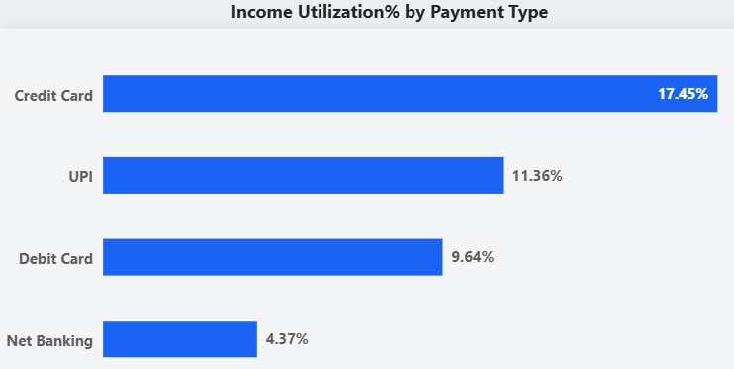
Credit Card : 17.45%
UPI : 11.36%
Debit Card : 9.64%
Net Banking : 4.37%

Slide 15


Strategic Suggestions

Slide 16


1.) Personalized Rewards for High-Value Age Groups
Insight:
Customers aged 25–45 show the highest income, spending & utilization potential.
Recommendations:
Offer cashback, reward points on transaction to drive daily usage.
Launch attractive sign-up bonuses (bonus points or cashback on activation).
Introduce low or zero annual fee cards to reduce entry barriers.
Provide higher credit limits aligned with income and spending capacity.

Slide 17


2.) Category-Centric Rewards for Essential Spending
Insight:
Major spending occurs in bills, groceries, and electronics.
Recommendations:
Offer enhanced cashback or bonus points on essential categories.
Partner with utility providers to give discounts or cashback on bill payments.
Collaborate with grocery chains and electronics retailers for exclusive offers.

Slide 18



3.) Tech-Driven Benefits for high potential segments
Insight:
Salaried IT employees and freelancers contribute shows higher Income Utilization.
Recommendations:
Introduce tech-focused reward categories (gadgets, software subscriptions, online services).
Provide brand partnerships and exclusive merchant offers.
Extend interest-free grace periods for work or business-related expenses.

Slide 19


4.) Advanced Security & Trust Building
Insight:
Security is a critical concern influencing credit card usage.
Recommendations:
Implement real-time transaction alerts & AI-driven fraud detection.
Ensure proactive customer support for suspicious transactions.

Slide 20


5.) Emergency Fund & Financial Flexibility
Insight:
Customers value financial safety during unexpected expenses.
Recommendations:
Enable quick access to emergency credit at reasonable interest rates.
Provide flexible repayment or EMI options for emergency spending.

Slide 21
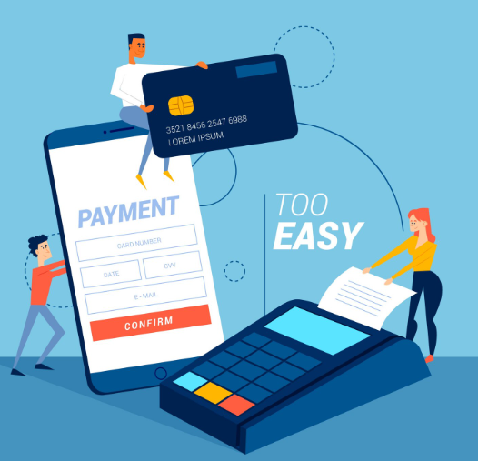
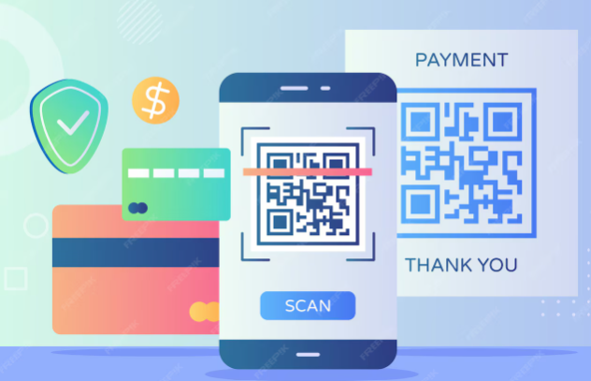
6.) Credit Card with UPI Integration
Insight:
Strong preference for digital payments and UPI adoption.
Recommendations:
Enable seamless Credit Card linking with UPI.
Offer cashback or bonus rewards on UPI-based credit card payments.
Implement a fast and simplified approval process to accelerate adoption.

Slide 22


